Slide 1



Gender in research training
Research Infrastructures
SiS.net Network Meeting and NCP Training
5-6 September 2019
Zagreb, Croatia

Slide 2


Katrien Van der Heyden
gender@yellowwindow.com

Slide 3
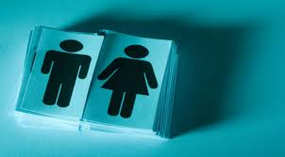
BASIC CONCEPTS
Notes:
3

Slide 4
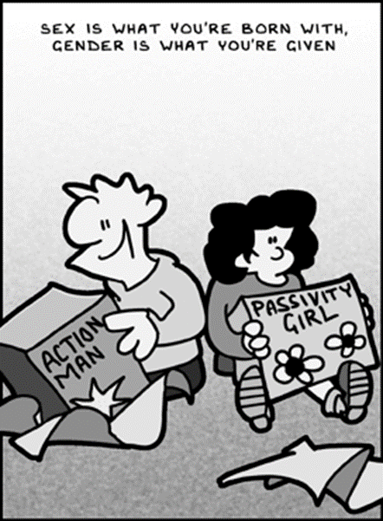
Basic Concepts
SEX refers to the biologically determined characteristics of men and women in terms of reproductive organs and functions based on chromosomal complement and physiology. As such, sex is globally understood as the classification of living things as male or female.
GENDER refers to the social construction of women and men, of femininity and masculinity, which varies in time and place, and between cultures.

Slide 5
Gender and sex?
In fact, there is a lot more variation in-between these boxes.
Sex
Gender
Male
Female
Masculine
Feminine
Notes:
5

Slide 6
My biological disposition
Sex
Male
Intersex persons
Female
Who I feel sexually attracted to
Sexual orientation
Homo-sexual
Hetero-sexual
Bi-sexual persons
How I feel about myself
Gender
identity
Male
Transgender persons
Female
How I present myself
Gender
expression
Masculine
Androgynous persons
Feminine
Notes:
6

Slide 7
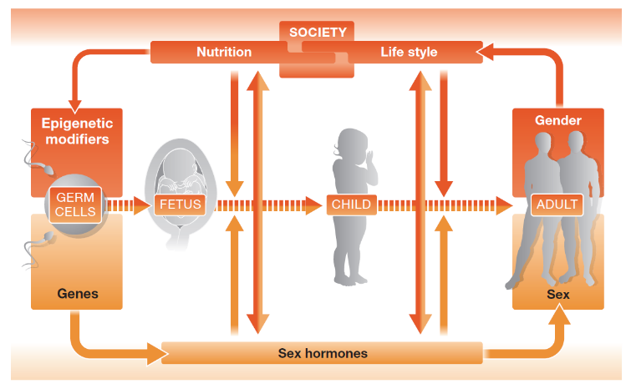
Also the link between biology and culture is
much more complex than we thought

Slide 8
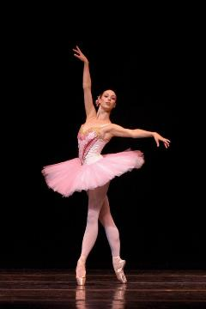

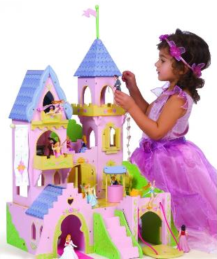
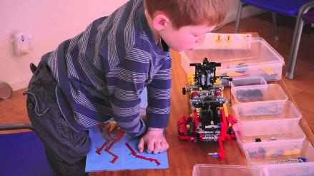
We create stereotypes and transmit them to the next generation(s)
Notes:
8

Slide 9
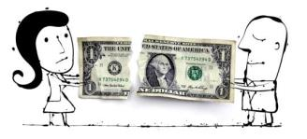
NOTE THAT:
The problem is not the difference between men and women as such, but the difference in how they are valued
Certain aspects associated with ‘masculinity’ still tend to be valued more highly
The result is inequality of opportunities, segregation & discrimination
Differences
Diversity
OK!
Differences
Inequality
Not OK!

Slide 10
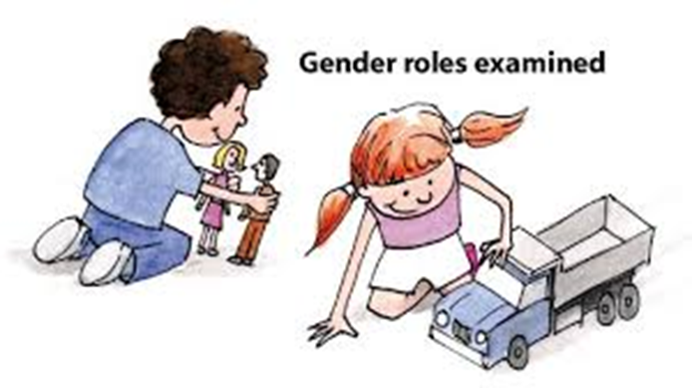
GENDER EQUALITY
A situation where individuals of both/all sexes are free to develop their personal abilities and make choices without the limitations imposed by strict gender roles. The (possibly) different behaviours, aspirations and needs of women and men are considered, valued and favoured equally.

Slide 11
Unconscious bias

Slide 12


Our brains trick us!

Slide 13
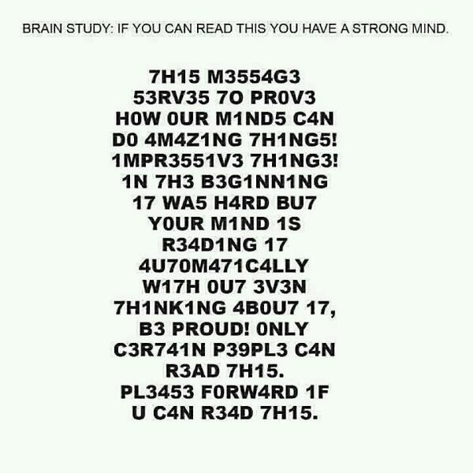

Slide 14
Please list the colors of these words out loud
RED
GREEN
ORANJE
YELLOW
PURPLE

Slide 15
Please list the colors of these words out loud
ചുവപ്പ്
പച്ച നിറം
ധൂമ്രനൂൽ
മഞ്ഞ
നീല
Notes:
This language is Malayalam, een taal uit Kerala, India.

Slide 16
Unconscious bias
“Unconscious bias is when we make judgments or decisions on the basis of our prior experience, our own personal deep-seated thought patterns, assumptions or interpretations, and we are not aware that we are doing it.” (Professor Uta Frith in a Royal Society briefing note)
Everyone has unconscious biases about which she/he is not aware.
This is especially problematic when we have to assess people, because it stands in the way of a fair judgement.

Slide 17
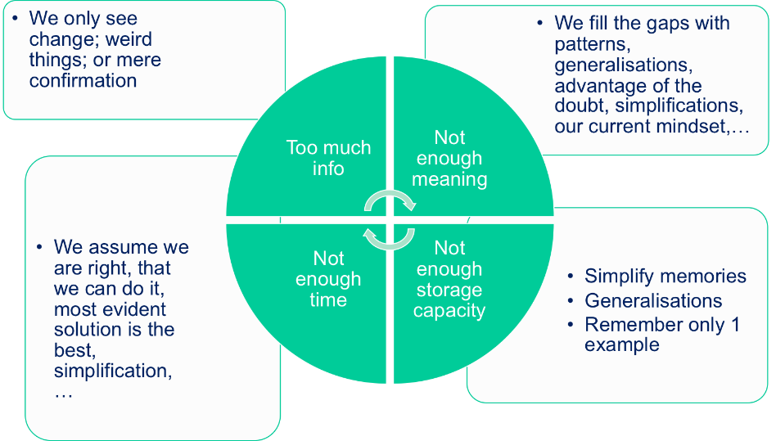

Slide 18


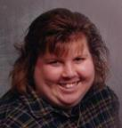

Example: negative impact of unconscious bias:
You’d better be handsome and/or male when looking for a job…
47% called
26% called
54% called
7% called

Slide 19
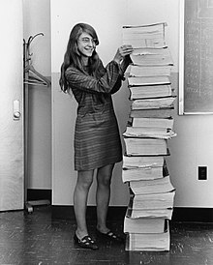


(Un)conscious biases influence job segregation
Female ‘computers’ doing astronomy research and making groundbreaking discoveries
Margaret Hamilton wrote entire software package that sent Apollo rockets to the moon
Ada Lovelace: British mathematician: laid foundation for software programming
Notes:
Women make up less than 20 % of ICT graduates in the EU, a figure that has been declining in recent years. Despite labour shortages in the sector, women will keep missing out on these job opportunities because of gender segregation that shapes their choices from an early age. Narrowing the gender gap in Science, Technology, Engineering and Mathematics (STEM) education is one way to create fairer economic growth. EIGE’s research shows that this would lead to more jobs (up to 1.2 million by 2050) and increased GDP over the long-term (up to 820 billion EUR by 2050). It would also improve the long‑term competitiveness of the EU economy, due to more exports and less imports that would contribute to an improved balance of trade.
Source: http://eige.europa.eu/news-and-events/news/study-and-work-eu-set-apart-gender

Slide 20
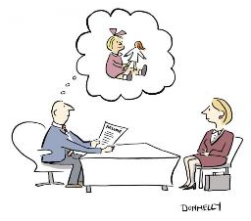
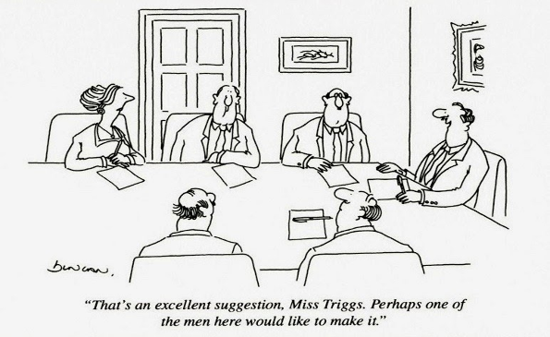
Unconscious bias in the workplace:
mensplaining, micro-aggression, …
That software is so simple, even your mother could use it!

Slide 21
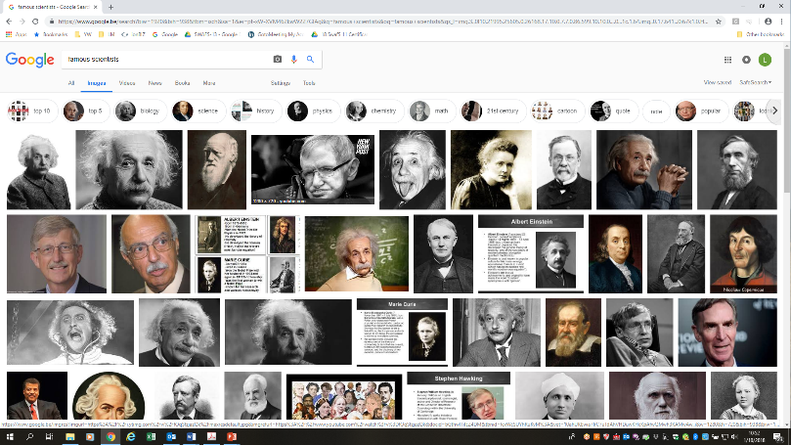
Google image search: ‘famous scientists’

Slide 22

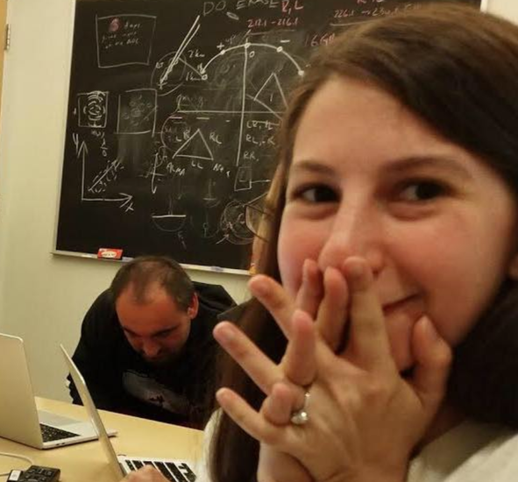
No, gender is NOT relevant when studying black holes.
However, gender equality in the research team remains relevant.
Example: bullying of Katie Bouman and her picture of a black hole.
Notes:
The misogynist trolls attacking Katie Bouman are the tip of the trashpile
Trolls latched on to Bouman’s achievement of the first black hole image with a vitriol that, in a saner world, would be shocking – but is par for the course for women
Jill Filipovic
Wed 17 Apr 2019 11.00 BSTLast modified on Wed 1 May 2019 19.52 BST
Katie Bouman. Photograph: MIT CSAILThe researcher Dr Katie Bouman played a leading role in taking the first photograph of a black hole. A photo of the 29-year-old Bouman taken the moment the photo was processed shows her with her hands clasped in front of her mouth, looking at the camera with a mix of shock and excitement. It went viral – both a testament to the groundbreaking work itself and a moment of victory for women in the sciences, whose contributions have long been ignored, downplayed and erased.
The giddiness didn’t last long.
Katie Bouman: the 29-year-old whose work led to first black hole photo
Read more
Anti-feminist trolls latched on to the story and attacked Bouman with a vitriol that, in a saner world, would be shocking, but in this one looked a lot like the reaction to a Ghostbusters movie remake with a female cast – that is, sad, angry men yelling at women on the internet. Trolls created fake social media accounts impersonating Bouman. They questioned her contribution to the project. When she said that she was part of a team who all worked hard to make the photo happen, they dug in deeper, suggesting she was only getting public attention because she was a woman, when men did all the real work.
Unfortunately, this is par for the course for women on the internet. Or women in politics. Or women on television. Or women who become prominent in any way, even if they are, like Katie Bouman, private citizens who did something truly amazing.
Zamir Mohyedin(@zamirmohyedin)Margaret Hamilton (left) standing next to pile of codes she wrote, that took first humans to moon.
Katie Bouman (right) who developed algorithm for the 1st Black Hole Image with the stack of hard drives containing all the data.
Legendary images. pic.twitter.com/ggtH2Cjzu2
April 12, 2019It’s easy to point to misogynist trolls as a problem; it’s also easy to write them off as just pathetic losers tweeting from their mothers’ basements. But in reality, they are the tip of the trashpile. Trolls say out loud what others think; trolls also embody the ugliest and most blatant versions of the more subtle sexisms that animate everyday life. While hundreds of petulant man-children rail against a female scientist on Twitter, there are undoubtedly a great many more men in the real world who wouldn’t call a woman the C-word (at least not in public, or at least not with their own names attached), but do think maybe there is something to the theory that men are just more mathematically and scientifically adept than women.
For each of the hundreds of whiners who proclaimed their childhoods ruined by female Ghostbusters, there are a hundred more men who may not care about the Ghostbusters saga, but would also have to be dragged to see a movie with an all-female cast and simply don’t consume many cultural products – books, movies, television shows, music – in which women dominate and men are either marginal or absent. For every guy still, in 2019, yelling expletives about Hillary Clinton, there are thousands and thousands more who would say they would love to support a woman for president … just not any of the actual women who are running or have ever run.
Women see how other women are treated when we shine or succeed – how quickly we are cut down, how insults snowball into threats – and are intimidated
Highlighting these attacks is crucial, if only to show the depth and degree of virulent misogyny. Too many women who have come into the public eye for any reason – or even women who are not in the public eye but spend time in online social spaces – know the feeling of being harassed, belittled, threatened and demeaned. Too many women have, as a result, piped down, shut up or bowed out. Untold numbers more never jump into the ring in the first place, keeping their voices down, their work quiet and their successes private.
I am sometimes invited to speak to journalism classes or to groups of college or high school students, and over and over again, I hear the same question: “How do you deal with the harassment?” I only hear this question from girls and women. Women see how other women are treated when we shine or succeed – how quickly we are cut down, how insults snowball into threats – and are intimidated. I never have a good answer, except to say that the internet can be a rough place for women, and to the extent you can ignore it or even work to change misogynist online culture, the better. But “ignore the bullies” is deeply unsatisfying and profoundly unhelpful advice.
Katie Bouman probably knows that. I don’t know how much time she spent online before this incident (she’s a computer scientist, so maybe quite a bit), but no doubt it has been jarring. But it goes beyond Bouman herself. Just as Bouman’s success was an inspiration to young women and girls in the sciences, the very public attacks on her work as a corollary warning. And that’s how we should understand this: not just as one of the ugliest forms of misogyny rearing its head, but as a pervasive, systematic part of a broader system that undermines women’s success and recognition at every level.
Attacks from sexist trolls are overwhelming and destabilizing. But far worse is the slow drip of sexism that keeps women from achieving their full potential for power, success and achievement every single day.

Slide 23

Gender based bullying in computer games
When girls/women threaten the male hierarchy, they tend to be bullied by males losing the game.
Notes:
14 Sep 2015: Kasumovic MM, Kuznekoff JH (2015) Correction: Insights into Sexism: Male Status and Performance Moderates Female-Directed Hostile and Amicable Behaviour. PLOS ONE 10(9): e0138399. https://doi.org/10.1371/journal.pone.0138399 View correction
Abstract
Gender inequality and sexist behaviour is prevalent in almost all workplaces and rampant in online environments. Although there is much research dedicated to understanding sexist behaviour, we have almost no insight into what triggers this behaviour and the individuals that initiate it. Although social constructionist theory argues that sexism is a response towards women entering a male dominated arena, this perspective doesn’t explain why only a subset of males behave in this way. We argue that a clearer understanding of sexist behaviour can be gained through an evolutionary perspective that considers evolved differences in intra-sexual competition. We hypothesised that female-initiated disruption of a male hierarchy incites hostile behaviour from poor performing males who stand to lose the most status. To test this hypothesis, we used an online first-person shooter video game that removes signals of dominance but provides information on gender, individual performance, and skill. We show that lower-skilled players were more hostile towards a female-voiced teammate, especially when performing poorly. In contrast, lower-skilled players behaved submissively towards a male-voiced player in the identical scenario. This difference in gender-directed behaviour became more extreme with poorer focal-player performance. We suggest that low-status males increase female-directed hostility to minimize the loss of status as a consequence of hierarchical reconfiguration resulting from the entrance of a woman into the competitive arena. Higher-skilled players, in contrast, were more positive towards a female relative to a male teammate. As higher-skilled players have less to fear from hierarchical reorganization, we argue that these males behave more positively in an attempt to support and garner a female player’s attention. Our results provide the clearest picture of inter-sexual competition to date, highlighting the importance of considering an evolutionary perspective when exploring the factors that affect male hostility towards women.

Slide 24
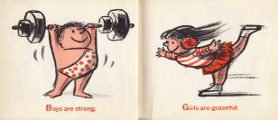
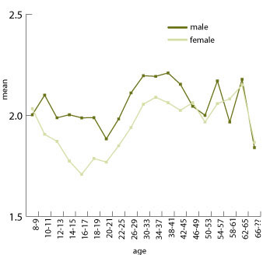
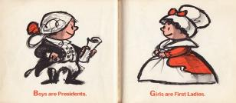
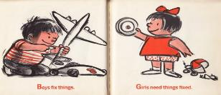
Self-Confidence

Slide 25

EUROPEAN POLICIES PROMOTING
GENDER EQUALITY IN RESEARCH

Slide 26


European Commission
Three objectives underpin the European Commission’s strategy on gender equality in research and innovation policy:
Fostering equality in scientific careers
Ensuring gender balance in decision-making processes and bodies
Integrating the gender dimension in research and innovation content, i.e. taking into account the biological characteristics and the social features of women and men

Slide 27
Equal Opportunities in research at all levels
Gender and sex variable in the research content
Gender in research

Slide 28
Equal Opportunities in research at all levels
Gender and sex variable in the research content
Gender in research

Slide 29
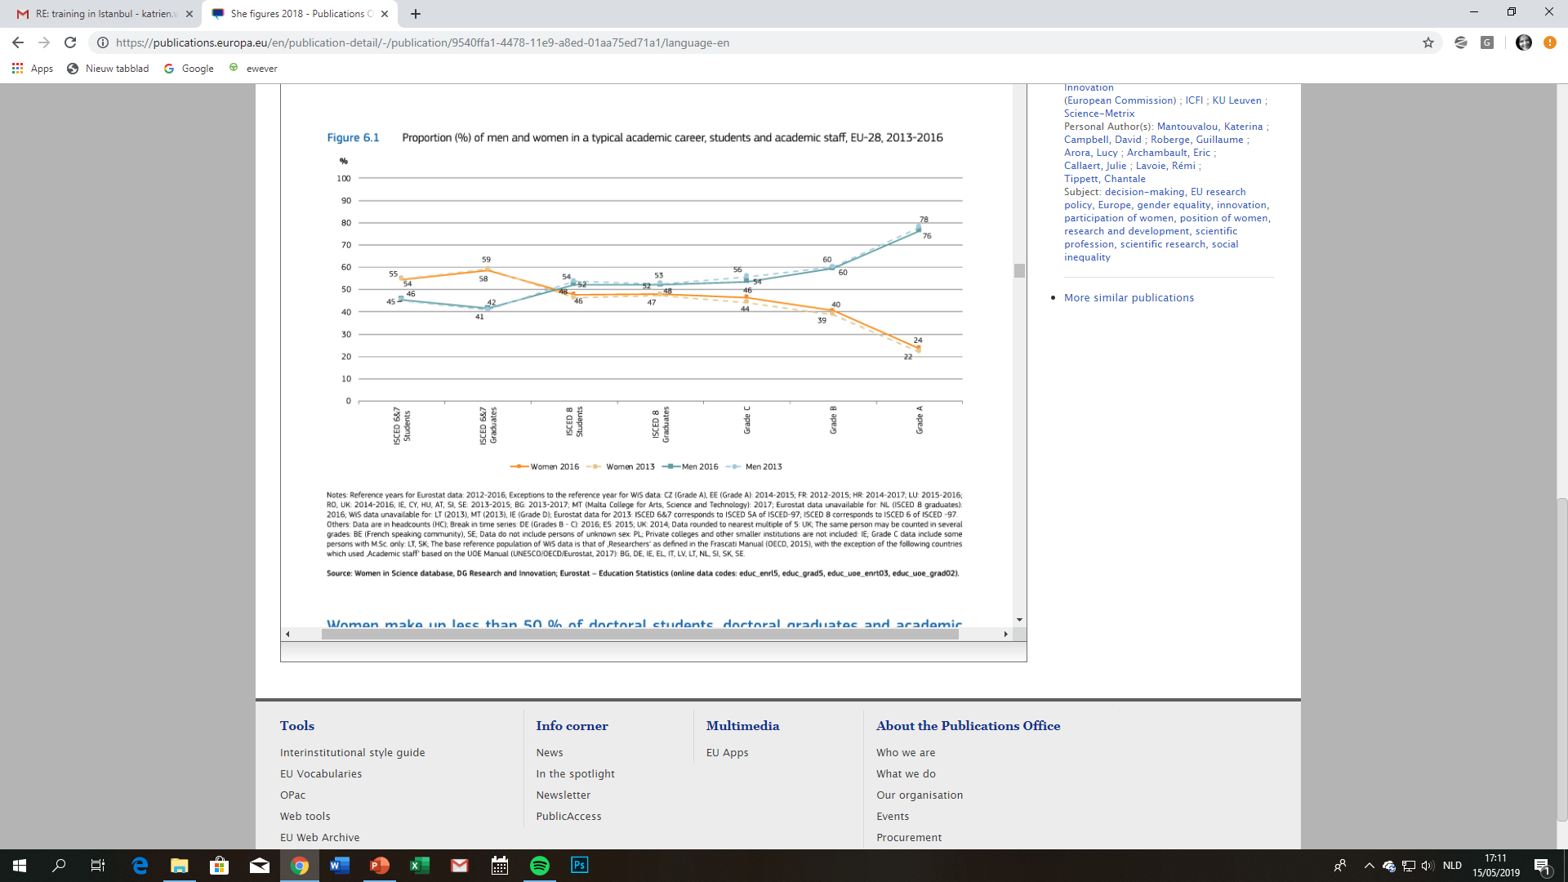

SHE – figures – 2015: Scissors diagram
In only eight out of 28 EU Member States did women account for more than 40 % of researchers.
Women in the EU have a stronger presence amongst researchers in the higher education and government sectors. In the business enterprise sector, they make up close to one in five researchers (2011).”

Slide 30
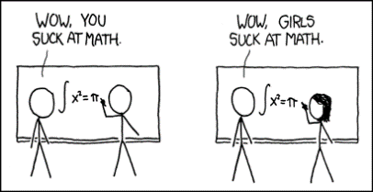
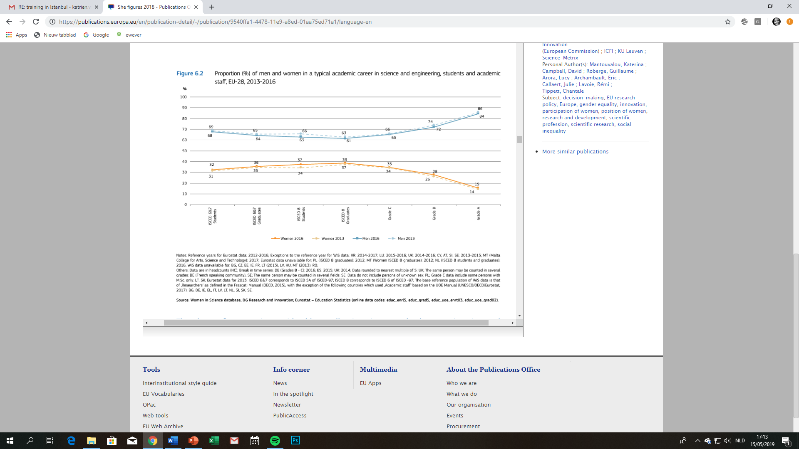

The gap is even bigger if we look at the proportion of women and men in the areas of science and engineering.

Slide 31

Gender Equality Plan
As defined by the European Commission, a gender equality plan consists of a set of actions aiming at:
Conducting impact assessment / audits of procedures and practices to identify gender bias.
Identifying and implementing innovative strategies to correct any bias.
Setting targets and monitoring progress via indicators.
European Commission Communication
on ‘A Reinforced European Research Area
Partnership for Excellence and Growth’ (COM(2012) 392 final)

Slide 32

Good practice examples - Areas of intervention:
Organisational culture:
  Organise gender training
Reconciliation of work and private life:
  Measures to facilitate return to work after parental leave
Recruitment, selection and career progression:
  Organise unconscious bias awareness sessions
Leadership and decision-making:
  Gender quota in all decision making bodies
Sexual and gender-based harassment:
  ‘Special Contact Person’ for sexual harassment
→ See GEAR tool: http://eige.europa.eu/gender-mainstreaming/toolkits/gear

Slide 33
Equal Opportunities in research at all levels
Gender and sex variable in the research content
Gender in research

Slide 34
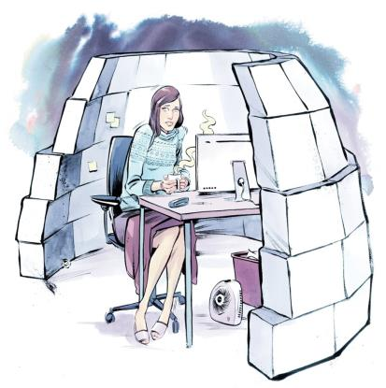
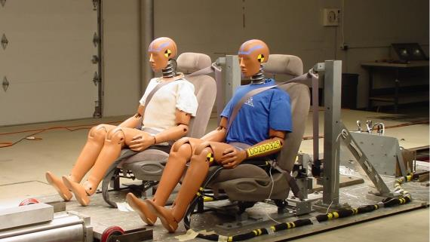
Unconscious bias slips into research as well
=> leads to dominance of the male norm
Algorithms that dictate temperature regulation in many office buildings were designed in the 1960 for the average man of 70 kg.
Seat belts are designed for people with the average height of a man

Slide 35

Dominance of male norm
Another example: the size of piano keys.
The universal piano keyboard size was standardized at a time when pianists were predominantly males of European descent.
This size is too large for many pianists.
This may explain why there are so few women at the highest levels of piano performance competitions, even though there are more women than men studying piano.
http://smallpianokeyboards.org/index.html
Notes:
http://smallpianokeyboards.org/index.html

Slide 36
By adding the sex / gender variables, the research gains quality and is less gender biased.
Gender in research content
Ideas phase
Proposal phase
Research phase
Dissemi-nation phase
Example :
Climate change and heat waves

Slide 37
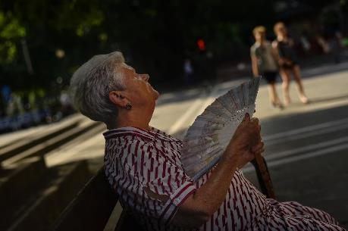
IDEAS PHASE
Is this research about climate change and heat waves or about the women and men suffering from the effects?
Sometimes we need to shift our focus and put humans back into the picture…

Slide 38
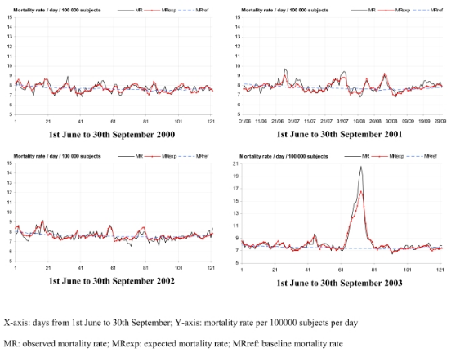
Excessive deaths due to heat wave in 2003, France
RESEARCH PHASE
Death spike due to heat wave: 14,748 excess deaths.
Notes:
Source: Published in final edited form as:
Int J Epidemiol. 2008 Apr; 37(2): 309–317.
Published online 2008 Jan 13. doi: 10.1093/ije/dym253
PMCID: PMC2652641
HALMS: HALMS207583
INSERM Subrepository
Has the impact of heat waves on mortality changed in France since the European heat wave of summer 2003? A study of the 2006 heat wave
Anne Fouillet,¹ Grégoire Rey,¹ Vérène Wagner,² Karine Laaidi,² Pascal Empereur-Bissonnet,²Alain Le Tertre,² Philippe Frayssinet,³ Pierre Bessemoulin,³ Françoise Laurent,⁴ Perrine De Crouy-Chanel,² Eric Jougla,⁴ and Denis Hémon^{1,*}
Author information ► Copyright and License information ►
https://www.ncbi.nlm.nih.gov/pmc/articles/PMC2652641/

Slide 39
Paris had the highest excess mortalities in France at 149% in the city and 174% in the surrounding suburbs.
A matched case-control study of excess mortalities in Paris and two other French cities found that while 35% of causes of deaths involved heat directly, another 37% were due to cardiovascular causes, and the rest respiratory, neurological and ill-defined causes ^{(Fouillet, et al., 2006)}.
Heat wave mortality is also associated with aggravation of underlying medical conditions such as nephritis and diabetes that are not normally associated with heat.
RESEARCH PHASE

Slide 40
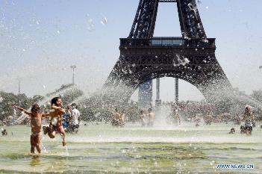
Variables that make people vulnerable during heat wave:
Urban environment
The dominant population vulnerability factor in heat waves is age
Gender was another factor correlated with population vulnerability, as women represented 65% of deaths, and men 35%
RESEARCH PHASE

Slide 41

Gender hypotheses:
RESEARCH PHASE
Longevity of women (living longer than men), does not explain the difference.
Social isolation is a big risk factor: absence of social activity increases risk 6-fold.
Low socio-economic status (poor housing, etc.)
Notes:
A general reason offered for this has been greater longevity among women which means within older age groups: First, although women in Europe and the US live longer than men, in Europe more elderly women die in heat waves, while in the US more men do ^{(Ebi & Meehl, 2007}; Klinenberg, 2003). Second, looking at the data from Paris in 2003, controlling for age reduces sex differences in mortality only slightly (-5%), with women still representing 60% of excess deaths ^{(Toulemon & Barbieri, 2005)}(Fig. 2B).
While some have suggested that women may have underlying physiological vulnerabilities, such as reduced sweating capacity ^{(D'Ippoliti, et al., 2010)}, the greater susceptibility of men in the US context suggests that gendered sociological factors in each region may play a more prominent role than any biological factors.
Social isolation, or living alone, has been identified by multiple studies as the most significant risk factor for death during heat waves ^{(Cadot, et al., 2007}; Kilbourne, 1997). In France, it was found that the absence of social activities led to a sixfold increase in risk of death during a heat wave among the elderly ^{(Vandentorren, et al., 2006)}. As well, mortality risks were much greater for those living at home (+74%) than those in public hospitals (+45%),
Low socioeconomic status (SES) has been shown by studies to be a risk factor for heat wave mortality across Europe. Rooms having poor insulation, no air conditioning, and located on the top most floor contributing to worse health outcomes
Source: Social Risk Factors for Heat Wave Mortality Among the Elderly: A case study of the 2003 heat wave in Paris, France
By Marzieh Ghiasi (Dec 2011)
http://ghiasi.org/2011/12/social-risk-factors-for-heat-wave-mortality-among-the-elderly/

Slide 42
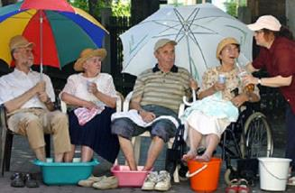
National Heat Wave plan:
set-up of a system for real-time surveillance of health data
compilation of scientific recommendations on the prevention and treatment of heat-related diseases
air-conditioning equipment for hospitals and retirement homes
drawing up of emergency plans for retirement homes
city-scale censuses of the isolated and vulnerable
visits to those people during the alert periods
and set-up of a warning system: repeated preventive message broadcasting by the media
All the Directorates-General of the Ministry of Health
were involved together with the Directorate-General
for Civil Defense and Security.
RESEARCH PHASE

Slide 43
Impact on excessive deaths: positive gender effect
Heat Wave 2006 | Observed | Expected (based on 2003 heat wave) | difference
Men 55-74 | 230 – 57% | 669 – 58% | - 439
Women 55-74 | 173 - 43% | 467 – 42% | - 294
Men > 74 | 536 – 43% | 1628 – 32% | -1092
Women > 74 | 740 – 57% | 3423 – 67% | -2683

Slide 44

Some tips….
Use sex-disaggregated datasets
Use research methodologies that allow a differentiated analysis of female and male target groups
Use gender-sensitive indicators to measure the impact of the research on women and men
Test your design(s) with female and male groups and pay attention to differences in user experience

Slide 45
Science with and for Society strategic orientations:
Accelerating and catalyzing processes of institutional change
Stepping up support to Gender Equality in Research & Innovation policy
Building the territorial dimension of SwafS partnerships
Exploring and supporting citizen science
Building the knowledge base for SwafS

Slide 46
Science with and for Society: strategic orientations
Let’s take a look at the gender dimension here.
Accelerating and catalyzing processes of institutional change
Stepping up support to Gender Equality in Research & Innovation policy
Building the territorial dimension of SwafS partnerships
Exploring and supporting citizen science
Building the knowledge base for SwafS

Slide 47
Institutional change
Science education
Ethics and research integrity
Standard operating procedures
Sciense4 Refugees
Re-use of research data
Etc.
In sub-groups: what do you think can be the gender relevance in each of these topics?
(1 subgroup = 1 topic)

Slide 48
Integrating sex / gender in a H2020 proposal
Make ‘gender’ visible straight away (e.g. in abstract, key words)
Budget: foresee resources; remember gender training is an eligible cost (budget for training under ‘other direct costs’)
Keep ‘gender’ in mind throughout the proposal preparation and drafting (gender balance in team; management structures; expertise in the consortium; research activities;…)
No ‘magic formula’ or couple of paragraphs
No ‘excellence’ without gender equality!
Mobilise expertise

Slide 49
Integrating sex / gender in a H2020 proposal
Technical part of the proposal:
Excellence:
1.1: Objectives: point out relevance; include analysis of sex / gender in relation to the main research topic as objective; explain which knowledge exists already and which are the gaps the research will fill
1.2 Relation to the Work Programme: especially when gender is flagged → explain how furthering gender knowledge will help advance the WP objectives
1.3 Concept and Method:
  a) Explain / show the gender expertise in the consortium (interdisciplinary research!), and if missing, say how this will be solved. Refer to existing research on sex/gender in relation to the topic and explain how the project will build on the existing research (if relevant)
  b) Explain the project’s approach to sex / gender throughout the research cycle
1.4 Ambition: include also a reflection on what the ambition of the project is in relation to gender knowledge

Slide 50
Integrating sex / gender in a H2020 proposal
Technical part of the proposal:
Impact:
2.1 Expected impacts: include gender! Point out any obstacles or barriers, e.g. missing sex-disaggregated data → explain how the project will contribute to solving this obstacle
2.2 Maximise impact
a) dissemination and exploitation: be consistent and integrate also sex/gender findings in how exploitation is planned; show what the added value will be; how including sex/gender variable will raise the quality of the research
b) communication: communicate findings! (conference papers; posters; research articles); show how results will be disseminated in a way that makes the sex/gender variable visible

Slide 51
Integrating sex / gender in a H2020 proposal
Technical part of the proposal:
Implementation
3.1: Work Plan: WPs and deliverables: integrate sex / gender throughout; show how the variables sex and/or gender will be taken on board; involve/consult relevant stakeholder groups and experts; consider separate deliverable on gender issues; present Gender Equality Plan in Management work package
3.2 Management structures: ensure gender balance in management structures!
3.3 Consortium as a whole: ensure and point out gender balance and gender expertise
3.4 Resources: gender training to be foreseen; sufficient resources for gender issues in the work plan

Slide 52
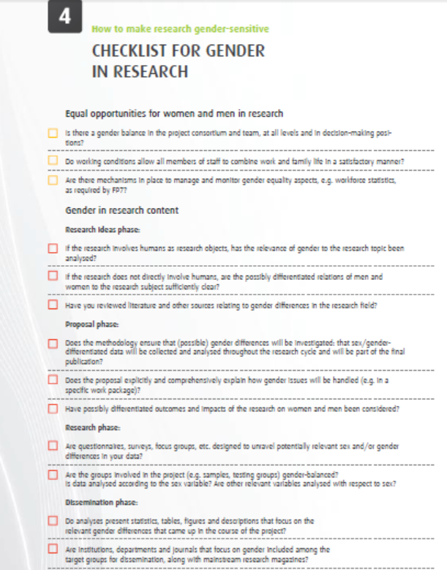
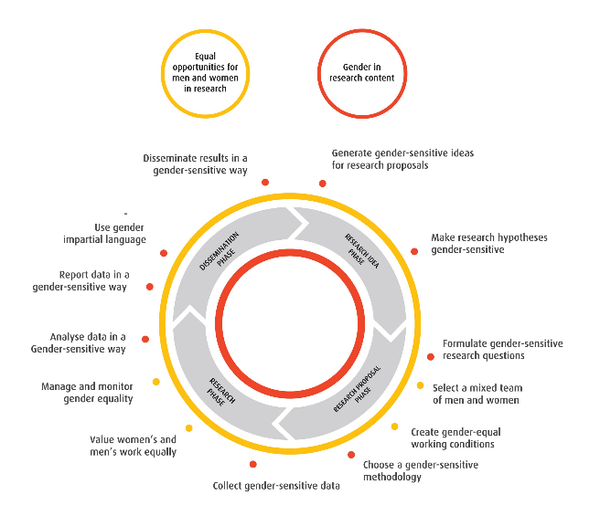
Tool: checklist, in https://www.yellowwindow.com/genderinresearch

